Slide 1


Slide 2
Getting started with
LogAlto

Slide 3
Training Objectives
1. Get familiar with LogAlto
2. Learn how to log in and edit your user profile
3. Create and edit a project. Understand the main components that make up a project
4. Begin to learn how to set up a logframe structure
5. Begin to learn how to create custom forms
6. Track your activities

Slide 4






1. Get familiar with LogAlto
Quick overview of the system

Slide 5
2. Learn how to log in and edit your user profile

Slide 6
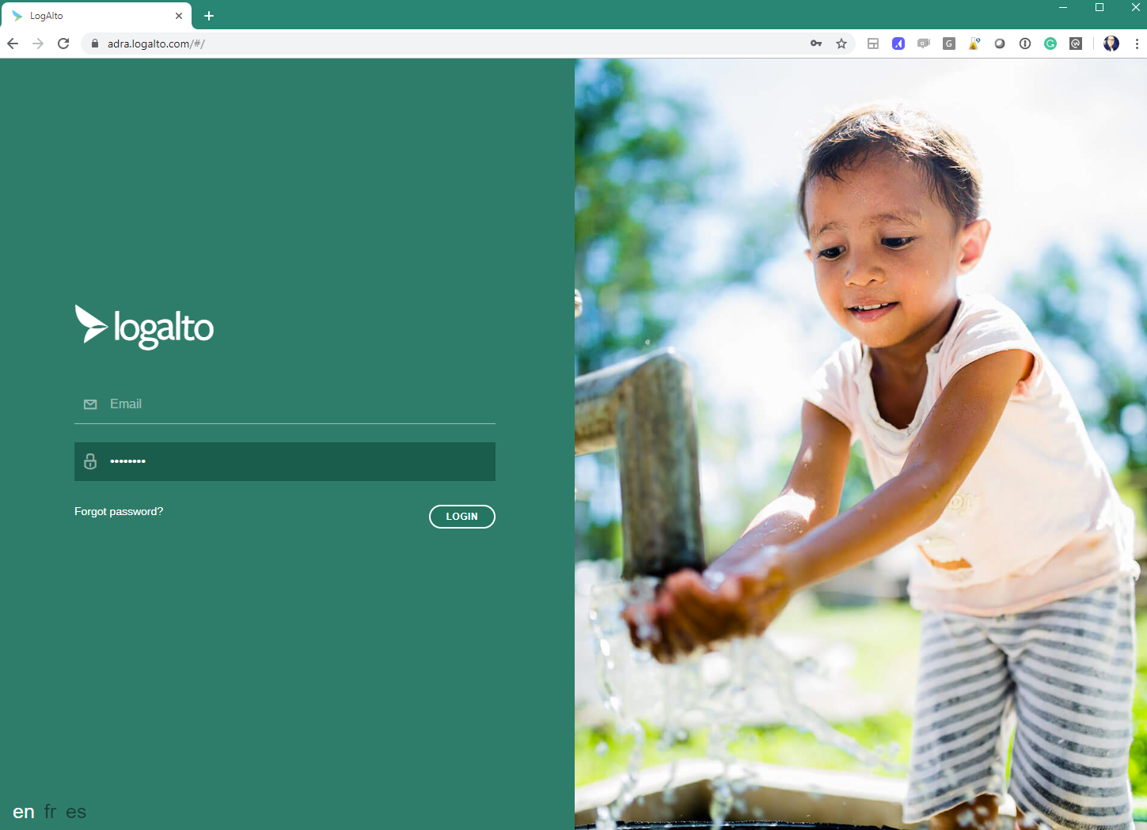
LOGGING INTO THE PLATFORM
In your browser type in: https://adra.logalto.com
LogAlto works best with Google Chrome
Enter your email and password here
If you do not remember your password click on: Forgot password
Choose in which language you wish to see the system

Slide 7
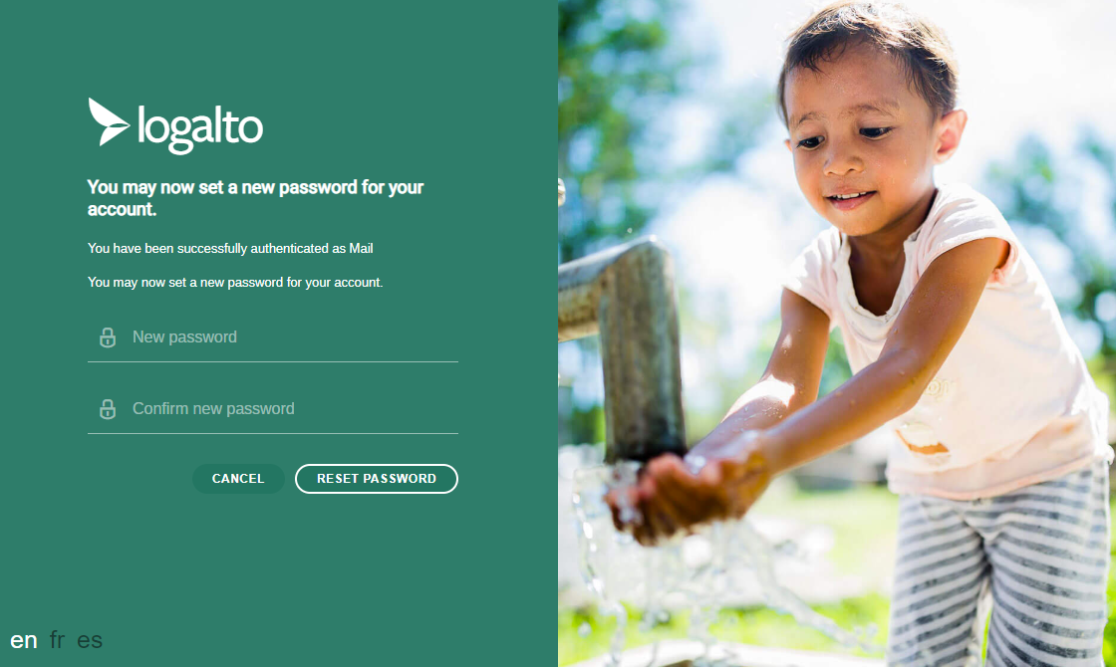
Set up your own password
The system will ask you to create your own password for future logins
It must be at least 8 characters long, with a combination of one symbol, number, or caps.
Enter your new password here

Slide 8

3. Create and edit a project. Understand the main components that make up a project

Slide 9
System structure
Project
Logframe
Budget (in the budget form)
Activities
Office
Indicators
Project Plan
Quarterly report
Network
Region
Implementing office
The project is the main component of the system.
A project is made up of different sections:

Slide 10
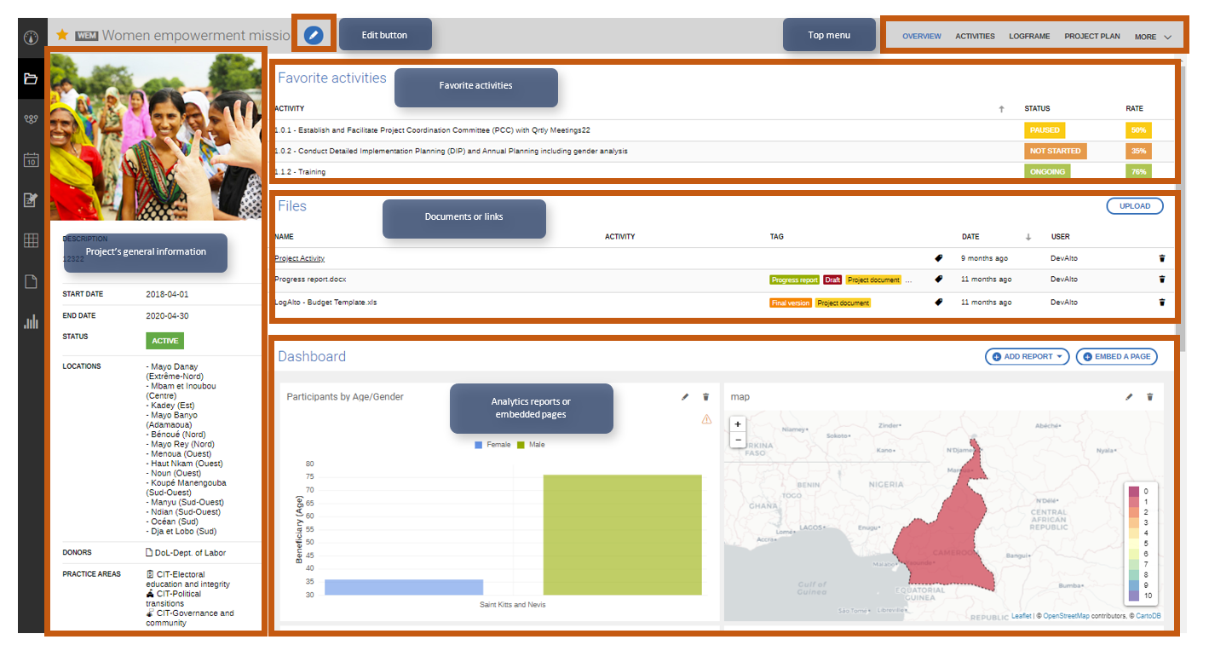
Project overview

Slide 11
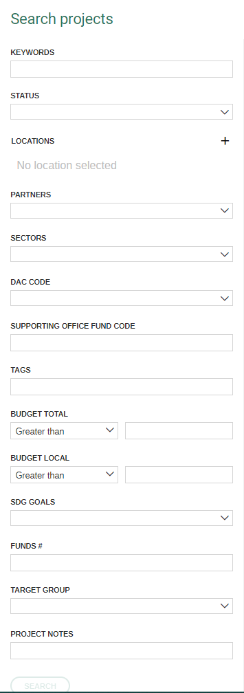
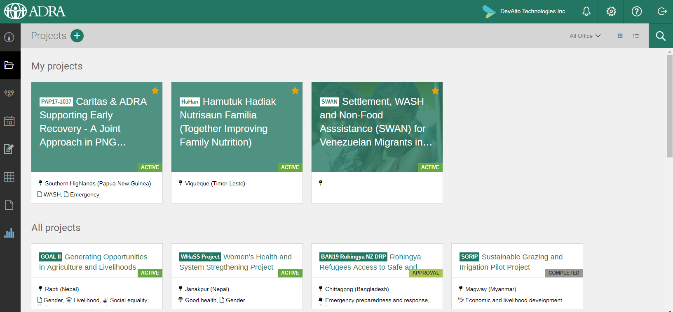

STEP 3: Update your project info
You can use the search tool to search for your project

Slide 12
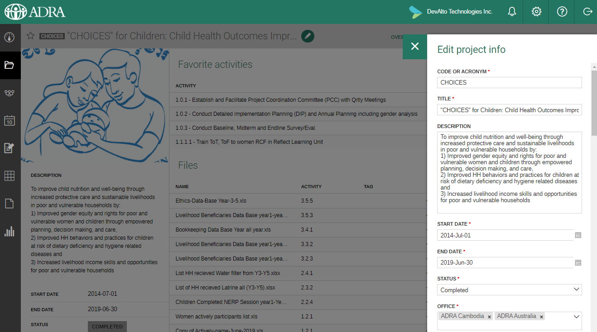
Update your project info
Click on the pencil icon and fill in the information in order to update your project

Slide 13

4. Begin to learn how to set up a logframe structure

Slide 14
Step 4: Enter your logframe
ADRA is currently tracking 2 global indicators.
Data that is entered in these indicators gets aggregated and allows the organization to create reports by region / office / sector.
You can enter your own project’s logframe and aggregate data at the office/ regional level.

Slide 15
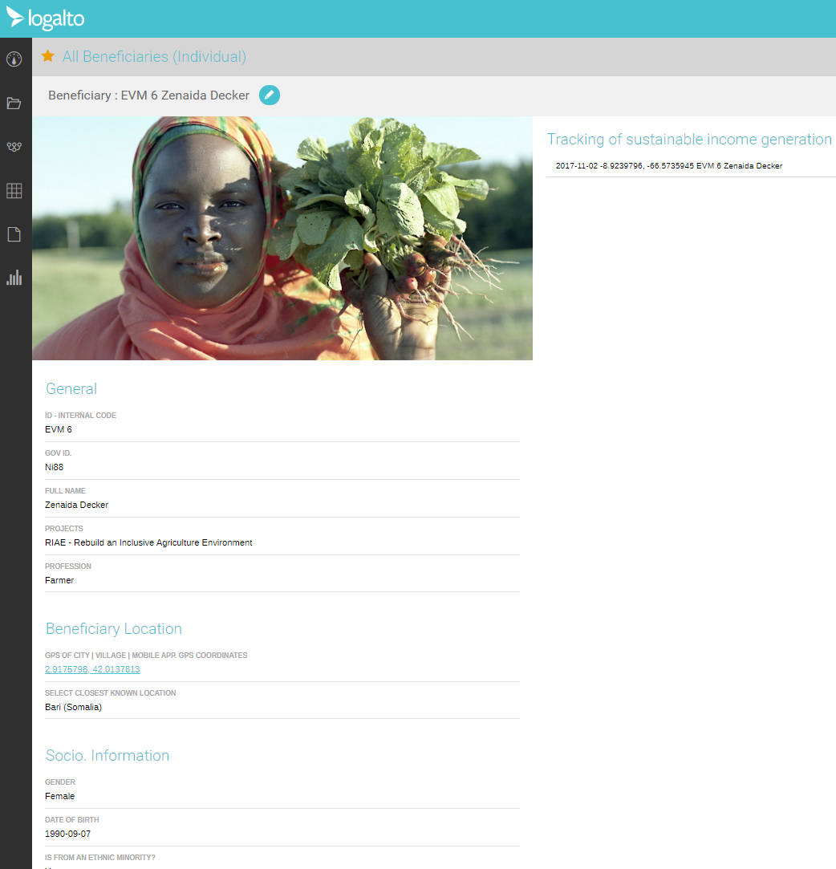
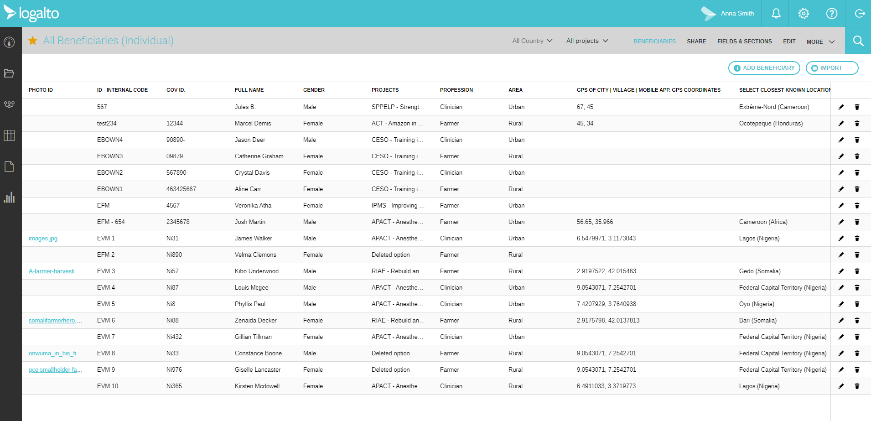
STEP 5: Create your forms
Track beneficiaries
Create surveys
Collect data

Slide 16
What is a form?
The custom form module allows users to create their own forms to collect data.
This can be used for anything that could otherwise be managed in Excel.
The advantage is that they can be collected offline, data can be imported through excel and then shared with colleagues and analyzed with the Analytics module. Data can also be linked to the logframe.

Slide 17
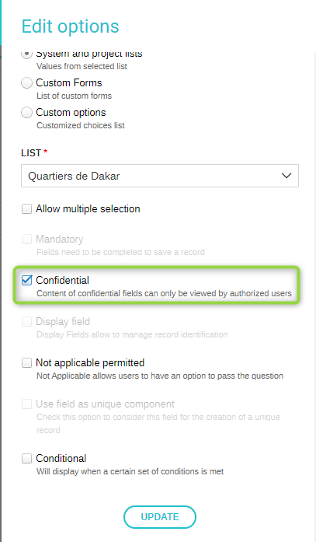
Confidential information
Fields can be confidential; this means that they will not be exported and that only users who are given access can see the content. Also, confidential fields will not appear in analytics reports.
When adding a field,
1. Click on the pen icon on the right-hand side of the selected field
2. Check the box ‘Confidential’ in the field form panel.

Slide 18
Steps for Successful Form Creation
1. Plan
Plan for your custom form creation
2. Create
Create project lists for predetermined options
3. Create
Create form and fields
5. Share
Share forms with relevant staff
6. Enter or Import
Enter or Import data
4. Test
Test your form to ensure that it works for your needs

Slide 19
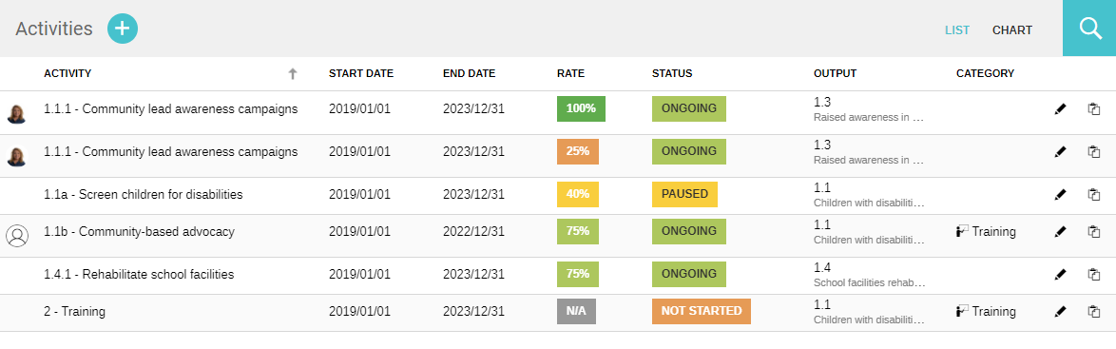
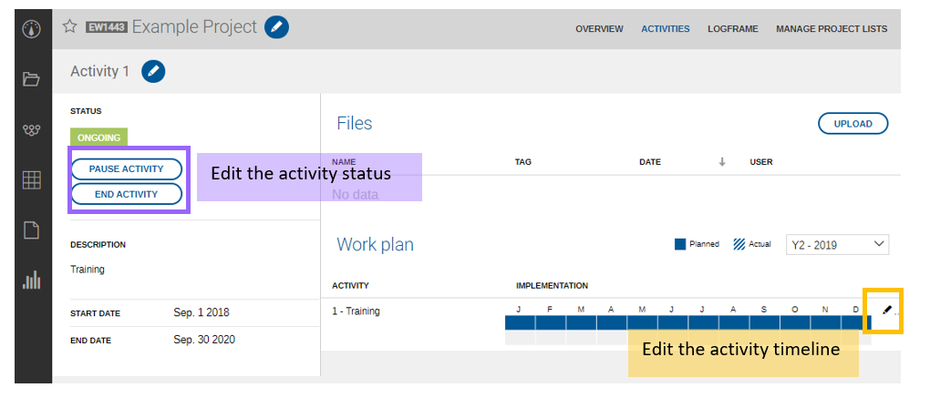
Activity Tracking
You can track the timeline of your activities and implementation rate with LogAlto

Slide 20
Useful links: Enter your logframe
Check out this video in order to know how to enter your logframe into the system
https://help.logalto.com/article/35-3-create-a-logframe
Also check out the articles here:
https://help.logalto.com/category/7-project-logframes-and-indicators-design

Slide 21
Useful links: Create your forms
Create forms in the system to collect data
https://help.logalto.com/category/8-forms-and-surveys
You can use the mobile app to collect data offline
https://help.logalto.com/category/13-mobile-application
You can import data through excel
https://help.logalto.com/article/108-import-data-from-excel

Slide 22
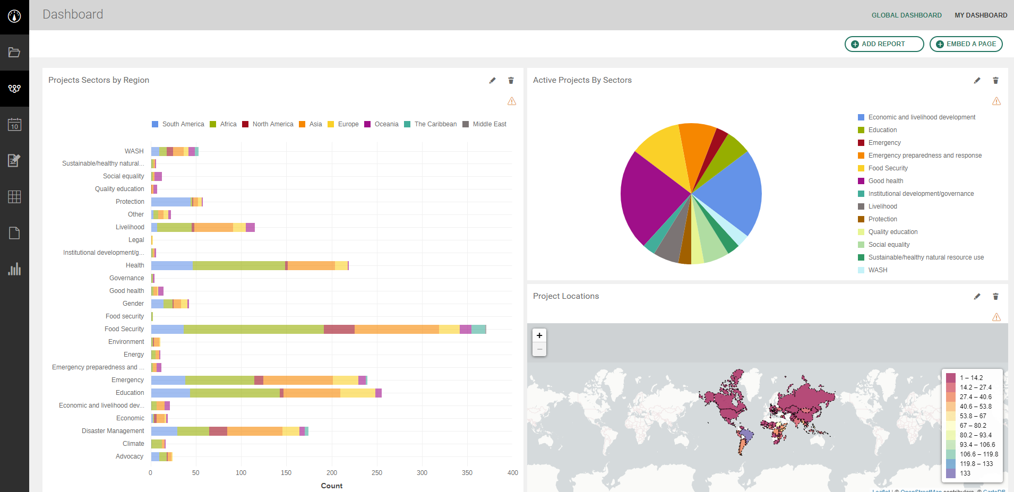
STEP 6: Create data visualizations
https://help.logalto.com/category/10-analytics-and-data-visualization

Slide 23

Don’t forget to use the help section https://help.logalto.com/
Questions?

Slide 24
You’re all set!
If you still have questions contact us at:
support@logalto.com

